Slide 1
Overview IPC in linux

Slide 2
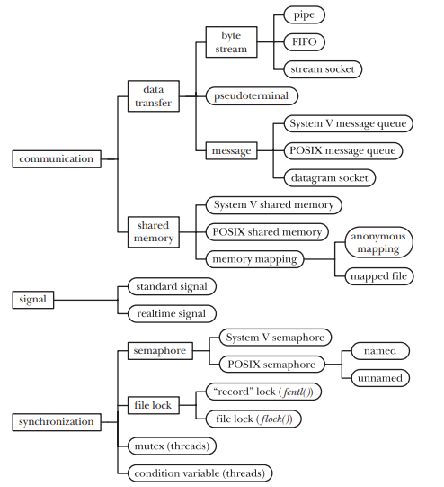
IPC CATAGORIES
IPC is a method to exchange information between processes and threads
Communication – exchange data
Synchronization – synchronizing the actions of process
Signal – Sometimes use to Synchronization or Communication

Slide 3
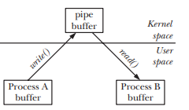
Communication issue
Various way to communication between 2 processes. There are 2 main categories
Data transfer
Writing/Reading – One process write data from user memory to kernel memory until other read (copy) data from kernel memory to user memory
Shared memory
Allow process to exchange information by placing it in memory region that shared between two processes
Kernel accomplish this by making page-table entries in each process point to the same page of RAM
Because communication doesn’t require system call or copy data between kernel space and user space, shared memory can provide very fast communication

Slide 4
DATA TRANSFER
There are 3 categories
Byte stream
Sequence of byte, reader can read any number of bytes regardless the size of block written by the writer
Pipe, FIFO, TCP socket
Message
An read operation read whole message with fixed size. It is not possible read a part of a message or read multiple message in one operation
POSIX message queue, UDP socket
Pseudoterminal
In special case one process use terminal other process like ssh
Some additional features
Read operation can involved by multi-reader, but reads are destructive, one reader consume data, data become not available to all remaining reader
Synchronization between the reader and the writer processes is atomic. If reader try to read data that writer is not yet fished his job, the reader block until data available

Slide 5
Shared memory
Synchronization
Semaphores
Is kernel maintain integer whose values is never permitted to fall below 0
A process want to access shared data, it try to decrease the integer
1->0 process have right to access data
0->-1 process block until other process increase integer
A process want leave shared data area, it try to increase the integer
0->1 blocked process wake up and it can access shared data area
1 -> it ok
File lock
Synchronization method explicitly designed to coordinate action of processes that operating the same file
File lock
Shared memory
POSIX shared memory and memory mapping
Shared memory need to synchronization between provider(writer) and consumer(reader). Semaphore is introduced to take the responsibilities
Data place to shared memory is visible to all readers

Slide 6
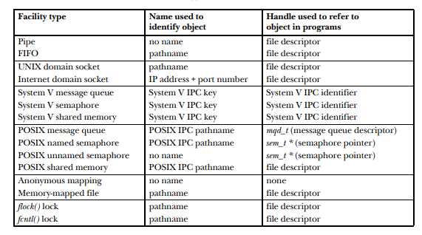
Comparing IPC facilities
Properties of various IPC

Slide 7

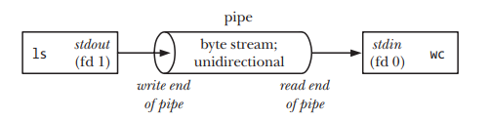
PIPEs
Shell create two process and execute ls and wc
Pipe create to send output of ls to wc
Pipe allow data flow from one process to other
Writing process (ls) write data to its standard output (fd 1) and reading process (wc) read data from standard input (fd 0) and pipe jointed to them until two process unaware the existence of pipe

Slide 8
PIPE PROPERTIES
Pipe is unidirectional
Data can only travel one direction through pipe
One pipe use for writing and other for reading
Pipe is atomic in writing
If multiple process write to pipe, data guarantee still in order if number byte written larger than PIPE_BUF(4096-page size)
Pipe is atomic in writing
Pipe is simply a buffer maintained in kernel memory. This buffer has limit capacity and when pipe full , write to pipe block until the reader removes data from pipe
Pipe is a byte stream
No have concept of message or message boundaries when using pipe
Reading process read block of data in any size regardless of the size of blocks written by writing process
Data passes through the pipe sequentially – byte read from pipe in exactly the order they are written
Attempt to read from pipe that currently empty block until at least one byte has been written to pipe
If the write end of pipe closed, then a process reading from pipe will see end-of-file (read 0)

Slide 9
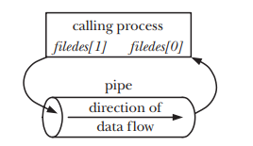
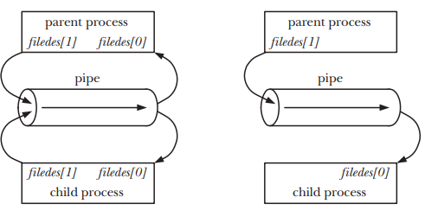
Create and use pipe
Pipe created
filedes[0] for read data from pipe and filedes[1] for write data to pipe
Pipe and fork
Parent and child communicate unidirectional
Close unused file descriptors
If two processes try to simultaneously read from a pipe, we can’t be sure which process will be the first succeed, two process race for data
Preventing such races need to synchronization mechanism
If multi-processes write to pipe, it it typical to have only a single writer

Slide 10
Closing unused pipe file descriptor
Pipe allow communication between related processes
It is normally two process communicated each other is parent and child,
Two process that have relationship can be used pipe for communication such as process and grandchild or two siblings process
Closing unused pipe file descriptor
Avoid limited file descriptor that a process can open
When a reading process close write descriptor, when writing process completes its output and close its write descriptor, reading process read end-of-file → reading process know end of communication and close pipe
If reading process is not close write descriptor and other close write descriptor, it isn’t seek the end-of-file→ wait data never coming
When a process tries to write to a pipe which no process has open read descriptor, kernel send SIGPIPE to process and process terminated

Slide 11
Pipes as a Method of Process Synchronization
Example to using pipe
Use example to explain Pipes as a Method of Process Synchronization

Slide 12
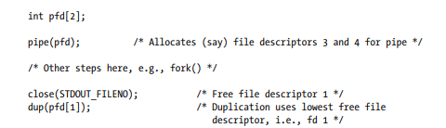
Using Pipes to Connect Filters
Back to ls | wc –l and understand how to implement it
Create two processes, one process invoke ls, other invoke wc and directive output of first process to input of second process
It is need to guarantee stdin is 0, stdout is 1 before use this technique

Slide 13
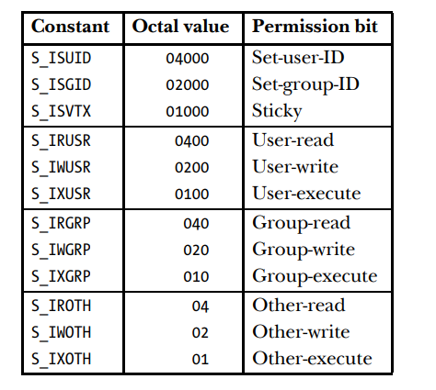
FIFO
FIFO similar with pipe
FIFO has name in file system and opened as a regular file
Used for communication between unrelated process
When FIFO open, the IO system call read/write/close can use with FIFO
Data read has same order with data written
First in, first out
When FIFO close, outstanding data will be discarded
Pathname is path to file on file system
Mode is permission of file

Slide 14
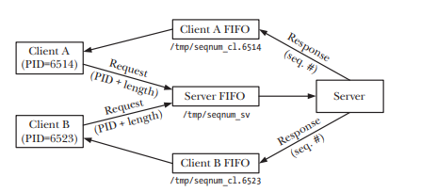
A Client-Server Application Using FIFOs
Application overview
All clients send their request to server using a single server FIFO
Clients knows pathname of FIFO that use connect to server before open connection to server
Each client has its pathname to server send response back to client
Server don’t know which file use to connect to client, it get this information by parsing message from client
It is possible to all clients use a unique file for response but multiple clients read FIFO at the same time, it cause race data because it cannot predict which process get data
Client build its pathname base on its process ID and sent it to server

Slide 15
Server requirement
Create server well known FIFO and open FIFO for reading
Server or client need to running first?
FIFO block open for read until open for write
Open more than one server for writing to avoid read end-of-file if all clients close the write
Ignore SIGPIPE to avoid terminate server
If server encounter an error in opening the client FIFO, it abandon client and continue server other request
It is a iterative server
Client requirement
Open client FIFO to server can response to it
Open well known server FIFO and sending request including its pid
Read and print server response

